Slide 1
Unit 6- Chemical Reactions
Grab a new unit 6 book

Slide 2
What we will be doing this unit
Writing and balancing equations
Already given products and reactants
Explore types of chemical reactions
You will only be given reactants
Can predict products and balance
Redox reactions

Slide 3
What is a chemical reaction?
The rearranging of atoms to form new elements, compounds, or both
Two components to a chemical reaction
Reactants – What your starting with
Products – What your end result is
CO₂ + H₂0 → C₆H₁₂O₆ + O₂
_{Reactants} _{Products}
The arrow always points to the products

Slide 4
Evidence of chemical change
Changes in energy | Formation of New substances
Release of energy as heat | Formation of a gas
Release of energy as light | Formation of precipitate (an insoluble solid)
Production of sound | Change in color
Reduction or increase of temperature | Change in odor
Absorption or release of electrical energy

Slide 5
Writing Chemical Equations
Writing Chemical Reaction is easy, but you have to know the naming rules in order to do it.
Aluminum metal and Iron (III) Oxide reacts to form Aluminum Oxide and Iron

Slide 6
Single Elements vs. Diatomics
Most elements are written by themselves
Examples
Aluminum metal is written using Al
Copper metal is written as Cu
Iron shavings are written as just Fe
Diatomics are written as two

Slide 7
Diatomic elements
Di- means 2!!
BrINClHOF
Anytime you have an element—meaning it is ALONE in a chemical reaction-- in BrINClHOF it has to be written with a subscript 2

Slide 8
Examples of Diatomics
Oxygen gas
Liquid bromine
Fluorine gas

Slide 9
Diatomics in a chemical reaction
Hydrogen gas and zinc (II) chloride are produced from the exothermic reaction zinc metal and hydrochloric acid

Slide 10
In a precipitation reaction, sodium hydroxide solution is mixed with iron(II) chloride solution. Sodium Chloride solution and insoluble iron(II) hydroxide are produced.

Slide 11
In a reaction Sodium and hydrochloric acid are mixed to form sodium chloride and hydrogen gas

Slide 12
Oxygen gas and magnesium are mixed and a Magnesium oxide precipitate is formed

Slide 13
Practice
Page 3,
Thou shalt not balance ye chemical reactional

Slide 14
I. magnesium metal reacts with nickel (III) nitrate to form magnesium nitrate and nickel metal.

Slide 15
1.
Zinc metal reacts lead (II) nitrate to yield zinc nitrate and lead metal

Slide 16
2
Aluminum bromide and chlorine gas yields aluminum chloride and liquid bromide

Slide 17
3
Sodium phosphate and calcium chloride yields calcium phosphate and sodium chloride.

Slide 18
Practice/ homework
Page 4

Slide 19
Balancing Equations

Slide 20
How many oxygens are indicated: 3 Ca(NO₃)₂
(PO₄)₄
4(CO₃)₂

Slide 21
Balancing reactions
Why do we have to balance??
Law of conservation of mass and energy.
Matter can never be created or destroyed, only transferred
What ever you have on the left side of the equation (reactants) must also exist on the right side (products)

Slide 22
RULES! RULES! RULES!
Hydrogen gas + oxygen gas yields water
H₂(g) + O₂(g) → H₂O
You cannot change the subscript
H₂ + O₂ ---> H₂O₂
You cannot place a coefficient in the middle of the formula
H₂ + O₂ ---> H₂2O
3. Make sure that your final set of coefficients are all whole numbers with no common factors other than one.
4 H₂ + 2 O₂ ---> 4 H₂O

Slide 23
MINHO CHEMISTRY
Helpful Hint
If you aren’t sure where to start balancing first, list your atoms in this order
Metals
Ions
Nonmetals
Hydrogen
Oxygen

Slide 24
Zinc metal is mixed with Hydrochloric acid to make Zinc(II) chloride and hydrogen gas.
Write the equation then balance
Zn + HCl ---> ZnCl₂ + H₂

Slide 25
Potassium Chlorate breaks down to create Potassium chloride and oxygen gas
Write the equation and the balance
KClO₃ ---> KCl + O₂

Slide 26
S₈ + F₂ ---> SF₆

Slide 27
Polyatomics Tricks
IF a polyatomic group appears EXACTLY THE SAME as both a reactant and a product, you can treat it as one thing
____Mg(NO₃) ₂ + ____Ag →____AgNO₃ + ____Mg
_____Ag _____
_____Mg _____
_____NO₃ _____

Slide 28
Practice
Page 1
Balance each equation and show your work
When finished, we will review as a class.
Page 2 is Homework

Slide 29
Reaction type | What happens | How to recognize | products
Combustion
Decomposition
Synthesis
Single Replacement
Double Replacement
Neutralization

Slide 30
What patterns do you see??
**these are all un-balanced**
C₂H₆ + O₂ ---> CO₂ + H₂O
C₆H₁₂O₆ + O₂ ---> CO₂ + H₂O
C₂H₅OH + O₂ ---> CO₂ + H₂O

Slide 31
Combustion
What does combustion mean?
the process of burning an organic compound (CH)
How do I recognize a combustion reaction?
Hydrocarbon, (organic) with CH + Oxygen
What are the products ALWAYS going to be?
CO2 and H2O

Slide 32
CH₃COCH₃ + O₂ --->

Slide 33
Butene - Write the combustion reaction -Balance

Slide 34
C₂H₆ + O₂ --->

Slide 35
Reaction type | What happens | How to recognize | products
Combustion | BURN | Hydrocarbon (organic) w/ CH + O2 | Products are CO2 and H2O
Decomposition
Synthesis
Single Replacement
Double Replacement
Neutralization

Slide 36
Practice
Page 5 (1-5)

Slide 37
Get out your chart
Reaction type | What happens | How to recognize | products
Combustion | BURN | Hydrocarbon (organic) w/ CH + O2 | Products are CO2 and H2O
Decomposition
Synthesis
Single Replacement
Double Replacement
Neutralization

Slide 38
What patterns do you see??
HgO ---> Hg + O₂
H2O ---> H₂ + O₂
MgCl₂ ---> Mg + Cl₂
Fe₂S₃ ---> Fe + S

Slide 39
Decomposition
What happens if a banana peel decomposes??
Breaks down into smaller pieces
How do I recognize??
AB →
Just one Reactant
What are the products??
→ A and B
Two products formed

Slide 40
Decomposition Reactions
Decomposition can also split one compound into two simpler compounds :
CaCO₃ ---> CaO + CO₂ Na₂CO₃ ---> Na₂O + CO₂ KClO₃ ---> KCl + O₂ Ba(ClO₃)₂ ---> BaCl₂ + O₂
Notice there is only one substance on the left-hand (reactant) side. This is always the case in a decomposition reaction. Don't forget that!!

Slide 41
CaCl₂ →

Slide 42
You try
Sodium Fluoride →

Slide 43
Practice
Page 6 (1-5)

Slide 44
Bellwork
Review homework
Decomposition and organic reactions

Slide 45
Bell work
Study for quiz (Balancing equations)
Get out homework to be checked
Page 7 #2,3,5,7,10

Slide 46
Quiz time
All you need is a pencil
We are skipping 1-4 on the quiz
Start at 5 and complete 5-11

Slide 47
Types of reactions
Combustion
Decomposition

Slide 48
See any patterns??
Mg + O₂ ---> MgO
Fe + O₂ ---> Fe₂O₃

Slide 49
Synthesis (opposite of decomposition)
What does synthesis mean??
Pieces form together to make larger compound
How do I recognize a synthesis reaction??
Two reactants being put together
What are the products??
One product formed

Slide 50
Synthesis Reactions
These are some examples:
H₂ + O₂ --->
K + Cl₂ --->
Fe + O₂ --->

Slide 51
Synthesis Reactions
Synthesis can also be two compounds making a more complex compound:
CaO + CO₂ ---> CaCO₃ Na₂O + CO₂ ---> Na₂CO₃ KCl + O₂ ---> KClO₃

Slide 52
Reaction type | What happens | How to recognize | products
Combustion | BURN | Hydrocarbon (organic) w/ CH + O2 | Products are CO2 and H2O
Decomposition | Compound breaks down into pieces | AB → One reactant | A + B Two products
Synthesis | Pieces bond together | Two reactants A + B → | One product → AB
Single Replacement
Double Replacement
Neutralization

Slide 53
Practice together
Finish synthesis on page 5 and 6

Slide 54
Practice mixed equation writing
Page 7
#10- 15

Slide 55
Bellwork
Review homework, any questions?

Slide 56
Bell work
Page 7 # 15 and 20

Slide 57
What patterns??
Cu + AgNO₃ ---> Ag + Cu(NO₃)₂
Cl₂ + NaBr ---> NaCl + Br₂

Slide 58
Single Replacement
What happens??
Free element breaks up compound
Cation replaces cation, or anion replaces anion
How do I recognize??
Ax + Y →
A + Yx →
What are the products?? (CRISS-CROSS!!!!!)
Ax + Y → A + Yx
A + Yx → Ax + Y

Slide 60
Single Replacement Reactions
Look at this reaction, what has switched places—the cations or anions?
Cu + AgNO₃ ---> Ag + Cu(NO₃)₂
Cl₂ + NaBr ---> NaCl + Br₂
Fe + Cu(NO₃)₂ --->
Ca + H₂O --->
Br₂ + KI --->

Slide 61
Practice Problems
1) ZnS + Fe --->
2) K + H₂O --->
3) Fe + HCl --->
4) NaI + Br₂ --->

Slide 62
Practice together
Page 8 examples I- example III

Slide 63
Al + Pb(NO₃)₂ →
Cl₂ + CuI₂ →
Ag + Ca(IO₃)₂ →

Slide 64
Practice on your own
Page 8
#1 - #5

Slide 65
What patterns??
KOH + H₂SO₄ → K₂SO₄ + H₂O
FeS + HCl → FeCl₂ + H₂S

Slide 66
Double Replacement
What happens??
Compounds break up and switch partners
Cations replace cations
Anions replace anions
How do I recognize??
AB + XY →
Two cations and two anions bonded
What are the products??
AY + XB AB + XY → AY + XB
Cations and Anions have switched partners

Slide 67
You will be given two compounds that will need to be uncross-crossed and then you need to criss-cross two new compounds

Slide 68
Double Replacement Examples
KOH + H₂SO₄ →
FeS + HCl →
NaCl + H₂SO₄ →
AgNO₃ + NaCl →

Slide 69
Practice together
Page 8 (Example IV, V, VI)

Slide 70
Class practice/Homework
Finish page 8
QUIZ TOMORROW ON REACTION TYPES
Synthesis, decomposition, organic, single replacement, double replacement

Slide 72
Bell work
Any questions on homework?
Page 8

Slide 73
Reaction type | What happens | How to recognize | products
Combustion | BURN | Hydrocarbon (organic) w/ CH + O2 | Products are CO2 and H2O
Decomposition | Compound breaks down into pieces | AB → One reactant | A + B Two products
Synthesis | Pieces bond together | Two reactants A + B → | One product → AB
Single Replacement | Free elements break up from compound Cations replace cations anions replace anions | AX + Y → A + XY → | YX + A XA + Y
Double Replacement | Compounds break up & switch dates | AB + XY→ | AY +XB Criss cross

Slide 74
Quiz time
You need a pencil and a periodic table

Slide 76
Neutralization
What happens??
Acid and bases react
Acid starts with H
Base ends with OH
How do I recognize??
Acid + Base are the only reactants
What are the products??
Creates Water (H2O) and Salt

Slide 77
Practice
Ex:
Ba(OH)2 + HCl →
HNO₃ + KOH →

Slide 78
Reaction type | What happens | How to recognize | products
Combustion | BURN | Hydrocarbon (organic) w/ CH + O2 | Products are CO2 and H2O
Decomposition | Compound breaks down into pieces | AB → One reactant | A + B Two products
Synthesis | Pieces bond together | Two reactants A + B → | One product → AB
Single Replacement | Free elements break up from compound Cations replace cations anions replace anions | AX + Y → A + XY → | YX + A XA + Y
Double Replacement | Compounds break up & switch dates | AB + XY→ | AY +XB Criss cross
Neutralization | Acid and base react | Acid – starts with H Bases – Ends with OH | Makes Salt and water

Slide 79
Practice mixed equations
Page 10 11-12
Page 11 11-12

Slide 80
REDOX reactions
Please grab a highlighter
Page 13

Slide 81
Bell work
Homework review
Page 10 and 11

Slide 82
practice
Page 16
Assign oxidation numbers and decide who is oxidized and reduced

Slide 83
Matter, Mass, and Volume
Matter
Anything that has mass and occupies space
Mass
A measure of the amount of matter
Volume
The amount of space that an object occupies

Slide 84
Mass vs. Weight
Weight depends on how hard gravity pulls on it
150 lb person on Earth weighs:
380 lb on Jupiter
10 lb on Pluto
25 lb on the Moon

Slide 85
Not Examples of Matter
- Ideas - truth, love, loyalty
- Heat
- Energy

Slide 86
Four states of matter
Solid
Liquid
Plasma
Gas

Slide 87
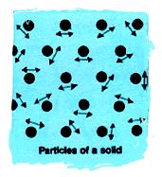
Solids (s)
Have a definite shape and definite volume.
The particles in a solid are packed tightly together and only vibrate gently around fixed positions.

Slide 88
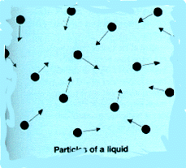
Liquids (l)
Have no shape of their own but take the shape of their container. A liquid does have a definite volume.
The particles in a liquid are free to move.

Slide 89
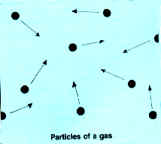
Gases (g)
Have neither a definite shape nor a definite volume.
The particles in a gas spread apart filling all the space of the container available to them.

Slide 90
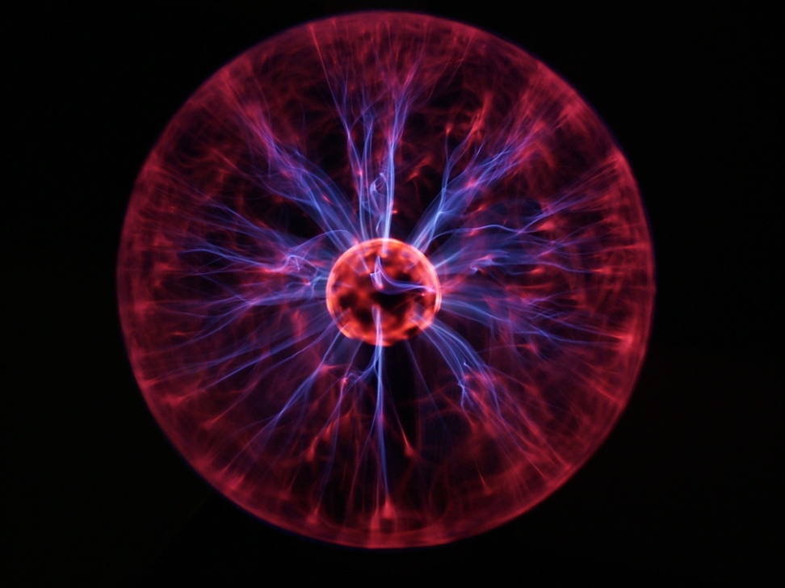
Plasma
High-temp state where atoms lose their electrons

Slide 91
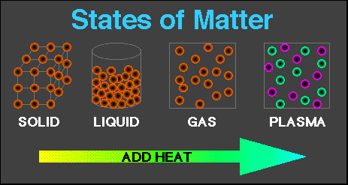

Slide 92
Physical / chemical change review
Video

Slide 93
Properties of Matter
Extensive Properties - depend on the amount of matter that is present. (Will change)
Volume
Mass
Energy Content (think Calories)
Intensive Properties - do not depend on the amount of matter present. (Will not change)
Melting point
Boiling point
Density

Slide 94
Chemical and Physical Properties of Matter
Physical Properties
- Color
- Odor
- Density
- Hardness
- Solubility
- Melting point
- Boiling point
Chemical Properties
- Chemical reactions with another substance
- Reactions with acids/bases and
other chemicals

Slide 95
Physical Change
If the shape, size or physical state is altered, but the chemical composition stays the same
Example:
Phase Changes
SOLID → LIQUID Melting
GAS → LIQUID Condensation
SOLID → GAS Sublimation
LIQUID → SOLID Freezing
GAS→ SOLID Deposition
LIQUID → GAS Evaporation

Slide 96
Chemical Change
A change in which one or more substances are converted into different substances.
Heat and light are often evidence of a chemical change.
Evidence of a Chemical Change:
- Production of a gas
- Formation of Precipitate
- (solid forms inside a liquid)
- Release or Absorption of Energy
- Temp change, light, etc.
- Color Change

Slide 97
POLYMERS

Slide 98
Introductory Terms
Macromolecule = “giant” molecule of living matter
Monomer = subunits that serve as the building blocks of a polymer
Example: Lego block
Polymer = monomers linked together
Example: Lego castle

Slide 99
Macromolecular Reactions ☺
Dehydration Synthesis:
2 molecules become covalently bonded to each other through the loss of water
Hydrolysis:
Water is used to break up polymers into monomers

