Slide 1
Moles
Pick up a Unit 7 book

Slide 2
You Learn
Read over page 1 in your work book
This page will help you complete page 2
~20 min

Slide 3
What is a mole?
Unit of measurement
The amount of substance contained in a substance
A mole has 6.02×10²³ atoms or molecules of the pure substance

Slide 4
Avogadro's Number
The actual number of particles in a mole is Avogadro’s number = 6.02 x 10²³.
1 mole = 6.02 x 10²³ atoms.
1 mole of feathers = __________atoms
1 mole of copper = ___________ atoms
1 mole of glass = _____________ atoms

Slide 5
RAM—Relative Atomic Mass (review from unit 2)
The average Relative Atomic Mass (RAM) of each element is given on the periodic table.
RAM = (%Isotope)(mass isotope) + (%isotope)(mass isotope
100

Slide 6
Practice
Calculate the RAM of the following
What is the average atomic mass of Boron if it exists as 19.90% ¹⁰B (10.013 g/mol) and 80.10% ¹¹B (11.009 g/mol)?

Slide 7
Molar Mass Definition
Molar Mass (MM) of elements/compounds—mass, in grams, equal to the atomic and formula masses .
Also known as Molecular Weight
Units = grams/mole. (g/mol)

Slide 8
Steps to finding Molar Mass
Find the Chemical Formula (write or given)
Find the number of atoms of each element using subscripts
Multiply subscripts by periodic table mass
-Round mass to 2 decimal places
4. Add up the pieces

Slide 9
Molar Mass Sample Problems.
H₂
H₂O
Cl₂

Slide 10
Even More Molar Mass
Aluminum sulfate
Potassium phosphate

Slide 11
More molar mass…
CO₂
KMnO₄
_{HF}

Slide 12
Practice
Page 2

Slide 13
Percent Composition
Part X 100 =percent
Whole
% composition- percent of total mass of the compound due to one element
Mass of part
Mass of whole

Slide 14
Percent Mass of Na and Cl in
Sodium Chloride

Slide 15
Percent mass of Iron, oxygen, and phosphorus in
Iron (III) Phosphate

Slide 16
Percent mass Potassium, in KCN
KCN

Slide 17
Page 3
Ammonium Nitrate

Slide 18
Practice page 3
On page 3 find the percent composition of each of the elements in 5 compounds
What you don’t finish is for homework

Slide 19
Bell work
Homework Check pages 2 and 3
Any questions?

Slide 20
Polyatomic Quiz
Put all things away

Slide 21
You need
Periodic Table
Calculator
Unit 7 book

Slide 22
Mole Video
https://www.youtube.com/watch?v=TEl4jeETVmg

Slide 23
Using moles to convert
Remember a mole is a unit of measurement
We can use it to convert between many units

Slide 24
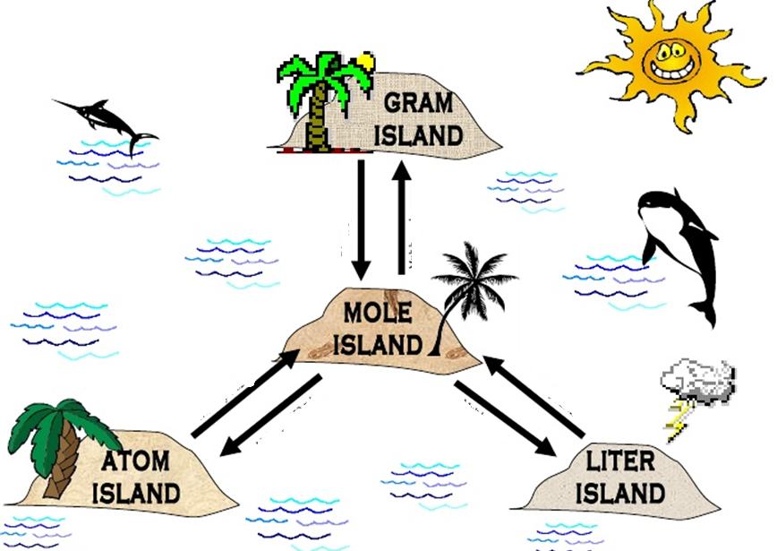
Mole Island
X grams = 1 mol
6.02X10^23 = 1 mol
22.4 = 1 mol

Slide 25
Steps to Dimensional Analysis
1. Start with what units you are given
2. Write down the unit you want to end in
3. Use conversions to find the units you need
4. Make sure all of your units Cancel
5. Divide and multiply as needed!!

Slide 26
Atoms → moles
How many atoms are in 3moles of Aluminum?

Slide 27
How many moles are in 1.2044 x 10²³ Molecules of water?

Slide 28
How many moles are found in 8.533 x 10²³ particles of glass?

Slide 29
Practice page 4
Mole-atom conversions
1-3

Slide 30
Moles → grams (mass)
We can also change between moles and grams. Molar Mass has units of g/mol
You must calculate the molar mass using the periodic table before you can do this

Slide 31
(Moles into grams)
How many grams of lead are in .67 moles of lead?

Slide 32
(moles to grams)
How many moles are in 10.2 grams of chlorine gas?

Slide 33
(moles into grams)
How many moles are present in 34 grams of Copper (II) chloride?

Slide 34
Practice moles-mass conversions
Page 4 and 5
1-3

Slide 35
Moles to Volume
We can also use moles to convert to volume of a GAS
1 mole = 22.4 L of any gas @ STP
STP = standard temperature and pressure
1atm
0 degrees Celsius

Slide 36
How many moles of O2 are in a container that has a volume of 12.2L?

Slide 37
A container is filled with 34.7 liters of CO2. How many moles of CO2 were pumped into the container?

Slide 38
Practice Mole- volume conversions
Page 5 and 6
1-4

Slide 39
Classwork / Homework
Finish pages 4-6

Slide 40
Bell work
HOME WORK check page 4-6
Any questions?

Slide 41
Mole island and Conversion Factors

Slide 42
Multi-step dimensional analysis
Today we will be using mole as a stepping stone between units.
Ex. How many atoms are in 560 grams of H2O.

Slide 43
Sample problem 3 (Grams to atoms)
How many atoms of carbon are in 16.39 g of carbon?

Slide 44
Sample Problem 4 (atoms to grams)
What is the mass of 1.34 x 10²⁴ atoms of cobalt?

Slide 45
Sample Problem 5
How many Liters of carbon monoxide are present in a 54 g sample?

Slide 46
How many atoms are present in 0.321 kg of calcium chloride?

Slide 47
Practice then review
Page 6 1-5

Slide 48
Home work
Finish page 10-12

