Slide 1
Bell work
Study your polyatomic IONS (3-4 minutes)

Slide 2
1. C₂H₃O₂⁻¹
8. NH₄⁺¹
2. CO₃⁻²
9. HCO₃⁻²
3. CrO₄⁻²
10. ClO₃⁻¹
4. CN⁻¹
11.OH⁻¹
5. NO₃⁻¹
12. MnO₄⁻¹
6. PO₄⁻³
13. O₂⁻²
7. SO₄⁻²

Slide 3
Acetate 8. Ammonium
Carbonate 9. Bicarbonate
Chromate 10.Chlorate
Cyanide 11. Hydroxide
Nitrate 12. Permanganate
Phosphate 13. peroxide
Sulfate

Slide 4
Bonding
How compounds are formed
Read pages 2-3

Slide 5
Bonding
Octet Rule – Atoms are stable with 8 valence electrons
Bonds are created when electrons are gained, lost, or shared so that an atom may fill its octet

Slide 6
Bonding- Important to remember
Valence electrons— The outermost electrons; the only electrons involved in a chemical bond
Core electrons—electrons inside the valence energy level not involved in chemical bonding
Chemical bonding—transfer or sharing e-

Slide 7
Types of forces
Intramolecular—chemical bonds
  Force between atoms within a compound
Intermolecular—Attraction b/w molecules
  Responsible for properties of compounds
  Ex. Melting point, boiling point, physical state

Slide 8
Intramolecular forces—types
Ionic bonds —transfer electrons
  Metal and Nonmetal
Covalent bonds—sharing electrons
  Nonmetal and Nonmetal
Metallic bonds—between metal ions and surrounding electrons
  Metal and Metal

Slide 9
Ions
Ion—atom, radical or molecule that has gained or lost one or more electrons.
  Has a positive or negative charge
Cation—Ion with positive charge.
  K→ K⁺, e⁻.
Anion—Ion with negative charge.
  Cl + e⁻ → Cl⁻.

Slide 10
Ionic Bonds
Occur between metals and non-metals
Strong electrostatic attraction between positive and negative ions
Crystalline structure
Solid @ room temp
Melt @ high temp
Good conductors of electricity in molten/dissolved state

Slide 11
Ionic Crystals/ crystalline
In ionic compounds the crystal is held together by electrostatic forces (the attraction between the + and - charges).
+ - + - + - + - + - + - + - + - +
- + - + - + - + - + - + - + - + -
+ - + - + - + - + - + - + - + - +
- + - + - + - + - + - + - + - + -
+ - + - + - + - + - + - + - + - +
- + - + - + - + - + - + - + - + -
+ - + - + - + - + - + - + - + - +
- + - + - + - + - + - + - + - + -
+ - + - + - + - + - + - + - + - +
- + - + - + - + - + - + - + - + -
However, crystals are really three-dimensional arrays of ions.

Slide 12
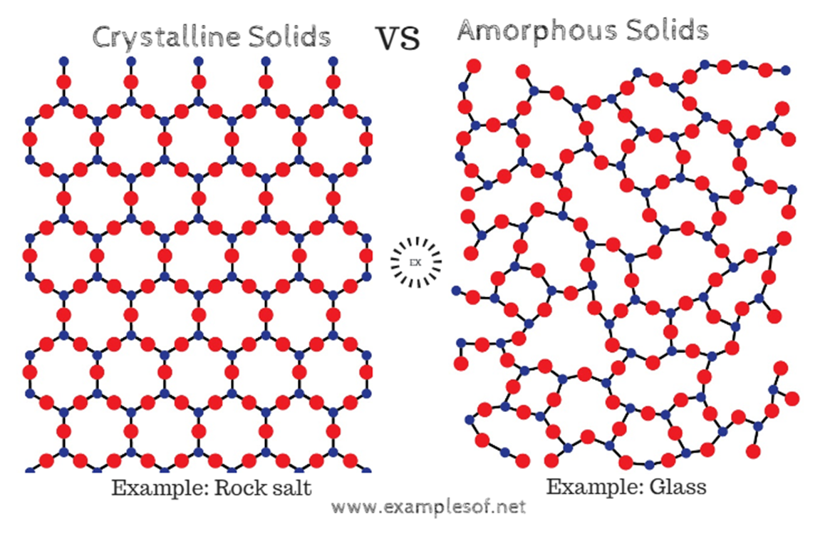

Slide 13
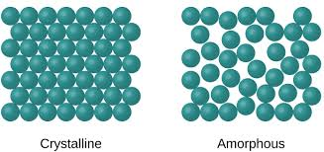

Slide 15
Examples
LiF
LiO
CaS

Slide 16
COVALENT BOND bond formed by the sharing of electrons

Slide 17
Covalent Bond
Between nonmetallic elements of similar electronegativity.
Formed by sharing electron pairs
Weak Bonds
they are not conductors at any state
Examples; O₂, CO₂, C₂H₆, H₂O, SiC

Slide 18
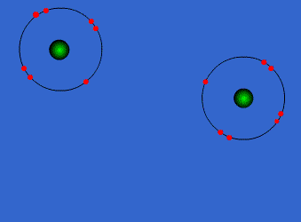
Covalent Bonds

Slide 19
Metallic
A bond that forms between two metals
Electrons are considered to be in a “sea”
  Not shared or transferred
Formulas are typically written as a neutral atom
Strong bonds

Slide 20
Practice
Determine each type of bond
KCl
CO
MnO
PF
Ti

Slide 21
Strength of bonds
Covalent bonds are the weakest by far
  Easily broken apart
Ionic and metallic bonds CAN both be very strong
Typically Ionic bonds are the strongest

Slide 22
Lewis Dot Diagrams
Lewis Dot Structures are representations of an elements valence electrons (s and p orbitals)
Can be used for individual elements or a compound

Slide 23
Lewis Dot Diagrams cont’d
Valence electrons the only electrons allowed to chemically bond. That is, the valence electrons determine the formulas of compounds that can be formed.
The core electrons do not contribute directly to bonding.

Slide 24
Lewis Dot Structures
O
                Ba
F
                Ar
S
                Al
I
                Ca

Slide 25
Read about Lewis Structures
Pages 4 and 5
Highlight the rules for drawing Lewis structures

Slide 26
Polyatomic Quiz
Study for your poly atomic quiz as I come around and check HW page 6 #1-9 bottom of page

Slide 27
C-NOPS
The only elements that can make double and triple bonds

Slide 28
Covalent Bonds & Lewis Dot
Lewis dot formulas were invented to help us show how electrons are shared.
· = valence electron
- = shared pair = :
For example,
write H₂ as H:H or H-H.
Arrange the molecule so that each atom is "surrounded by" eight dots in pairs
(except for H, Li, Be, and possibly B).

Slide 29
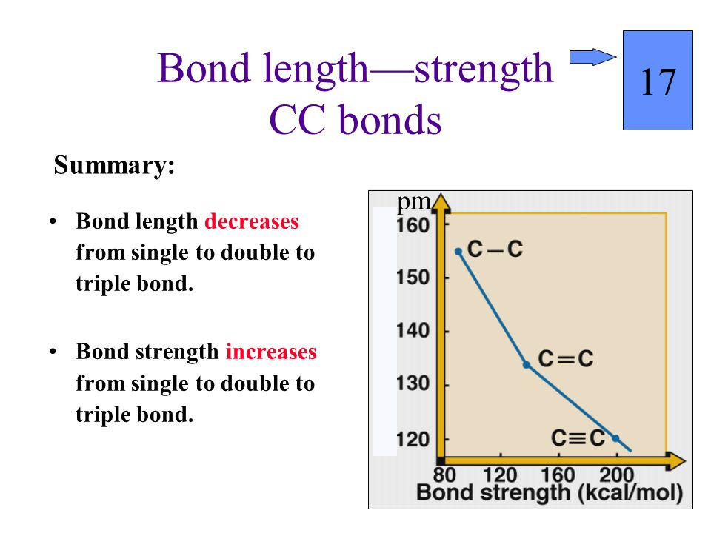

Slide 30
Octet Rule
States that atoms tend to combine so that they each have eight electrons in their valence shells, giving them the same electronic configuration as a noble gas.
Exceptions
  B & Al only need 6 to be “happy”

Slide 31
Bell work
Study your polyatomic IONS (3-4 minutes)

Slide 32
1. C₂H₃O₂⁻¹
8. NH₄⁺¹
2. CO₃⁻²
9. HCO₃⁻²
3. CrO₄⁻²
10. ClO₃⁻¹
4. CN⁻¹
11.OH⁻¹
5. NO₃⁻¹
12. MnO₄⁻¹
6. PO₄⁻³
13. O₂⁻²
7. SO₄⁻²

Slide 33
Drawing Lewis Diagrams for Molecules
Determine the total number of Valence electrons (taking into account any charges present)
Decide who is the central atom. (usually the least electronegative but never hydrogen).
Arrange the remaining electrons to complete the octets
If the central atom lacks an octet form multiple bonds (double or triple) by converting non-bonding electrons from terminal atoms into bonding pairs.
One bonding pair of electrons represents one covalent bond that in turn can be represented by one line ( ⎯ ).

Slide 34
HW
Page 8
Group A- pick 3
Group B- pick 2
Group C pick 2
Page 9
Group D- ALL
Group E- pick 3

Slide 35
Lewis Structure – Single Bonds
NF₃
CHCl₃
PH₃
ClO₃⁻¹
Complete Section 2

Slide 37
Lewis Structures – Multiple Bonds
SO₂
CS₂
CO₃⁻²
Complete Section 3

Slide 38
Resonance Structures
Occasionally when drawing a Lewis structure that involves multiple bonds it may be possible to draw a number of different, correct, Lewis structures. In such a case we call the various structures resonance structures.

Slide 39
Lewis Structures – Expanded Octet
1. BrF₅
2. I₃⁻¹
3. BrF₃
Complete Section 4

Slide 40
Lewis Structures - Exceptions
1. AlH₃
2. BCl₃
Complete Section 5

Slide 41
Quiz today
Study, 3-5 minutes
When finished read pages 10-11

Slide 42
Valence Bond Theory page 10
  VBT helps describe how bonding occurs.
  Explains which atomic orbitals must have overlapped. (hybridization)
  Explains the geometrical shape of bonds.

Slide 43
Hybridization
Combining two or more orbitals of nearly same energy level to a new orbitals of equal energy
Occurs to increase number of bonding sites.

Slide 44
SP³ Hybridization of Methane – CH₄
₋ Carbon only has two bonding sites so it must hybridize orbitals to attach all four hydrogens

Slide 45
Determining Hybridization
Count the bonds around central atom
  Non-bonding electron pairs count
  Double and triple bonds count as one
Determine Hybridization of:
  SCl₆
  H₂0
  NO₃⁻¹

Slide 46
Practice
Page 15
#1-5
You can draw the structure
Count Valence electrons
Hybridization

Slide 47
Try These Hybridizations:
  CCl₄.
  MgF₂.
  CH₄.
  SO₄²⁻.
  PCl₅.

Slide 48
Review
Determine the lewis structure and hybridization of each of the following
CO₂ 3) PCl₅
2) NO₃⁻¹ 4) SCl₄

Slide 49
Polyatomics
Quiz today… Study
I’ll check homework pg 15

Slide 50
After Quiz
Read / review pages 11-14

Slide 51
Molecular Geometry
VSEPR

Slide 52
Valence Shell Electron Pair Repulsion (VSEPR) (11)
Atoms involved in bonding will arrange themselves to minimize electron pair repulsions
The angle between bonds will be the greatest possible
Unshared pairs occupy more space than shared electron pairs thus causing shared pairs to be pushed closer together

Slide 53
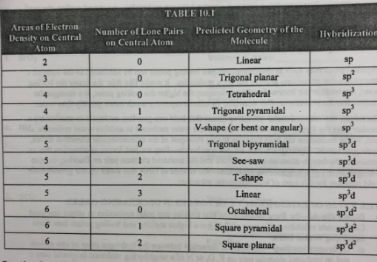

Slide 54
Try these molecules
Predict the shape of the following molecules:
- Draw Lewis Dot Structure
- Give Hybridization of the central atom
- Identify Lone Pairs of Electrons
CO₂ 3) PCl₅
2) NO₃ 4) SCl₄

Slide 55
Bell work
Study your polyatomics

Slide 56
After Quiz
Determine the Lewis Structure, Hybridization, and shape of each of the following compounds
H₃O⁺
SO₂

Slide 57
Homework
Check and review

Slide 58
Practice
Page 15 determine the shape of each of the problems you did for homework

Slide 59
Polar Covalent vs. Nonpolar Covalent

Slide 60
Polar Covalent Bonds
A molecule is considered polar if there are uneven electrical forces acting on the central atom
A polar molecule results when a molecule contains polar bonds in an unsymmetrical arrangement.
In determining if something is polar or not there are two things to look for:
  Lone pairs of electrons
  Different kinds of atoms bonded to the central atom

Slide 61
Polar or Nonpolar
H₂0
CCl₄
NH₃
CH₃Cl

Slide 62
Nonpolar Molecules
A molecule where all electrons are shared equally
  The pull from the central atom is equal in all directions
Ex) CH₄

Slide 63
practice
Page 15- find the polarity of each of the problems you finished for homework..

Slide 64
Inter vs Intra
Intramolecular forces: The forces WITHIN atoms in a compound
  Covalent
  Metallic
  Ionic
Intermolecular Forces: the forces BETWEEN compounds

Slide 66
Types of Intermolecular Forces
Named for the Dutch scientist who discovered them – Called Van der Walls Forces
3 Types (know all three and how to predict them)
Dipole-Dipole
Dipole- Induced Dipole
Induced Dipole- induced Dipole

Slide 67
Dipole Moments
Polarity = Dipoles
Polarity results in dipole moments
Dipoles are separation of charges (+ and -)
  Can lead to molecules having strong intermolecular forces

Slide 68
1. Dipole – Dipole
Force of attraction between 2 polar molecules
Compounds with this type of force have higher melting and boiling points due to the strength of the force
Hydrogen bonding—the force of attraction between the hydrogen atom of one molecule and an unshared electron pair on F, O, or N of a neighboring molecule
  Think Water

Slide 69
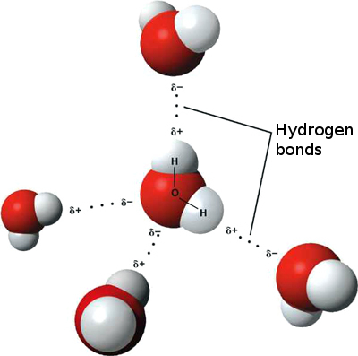
Hydrogen Bonding

Slide 70
2. Dipole – Induced Dipole
Attraction between a polar and a nonpolar compound
  Polar molecule induces a temporary dipole (polarity) in the nonpolar molecule
Larger molecules have more electrons and are therefore more inducible than smaller molecules
Attraction is not as strong as Dipole – Dipole forces

Slide 71
3. Induced Dipole - Induced Dipole
Attraction between two nonpolar molecules
  AKA: London Dispersion Forces (LDF)
Since all molecules contain e⁻, all molecules have LDF forces
Larger molecules = More e⁻ = Greater LDF
Weakest type of attractive force

Slide 72
MAKE sure you are keeping up with your formula/ cheat sheet
Write important things down that are easily forgotten for later in the year
This unit: write your Lewis structure rules/steps
Types of bonds

