Slide 2
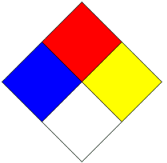
Tell what each color (quadrant) means (4 points)
What is the scale? (not severe → severe)
2 points

Slide 4
Google
This semester we will be doing a portion of class online through google classroom.
Get a computer, log on, and get acquainted with your google email

Slide 5
Step 1
Log on to your google email
If you do not have internet access at home, please send me an email right now (using the proper email etiquette we just reviewed)
Next, go to the Franklin County High School Webpage

Slide 6
Step 2
On the FCHS webpage, go to the “FACULTY” section. Find my name in the science department section and click on my website
Here you will find powerpoints for each unit, as well as links to videos that can help you master chemistry. You are allowed to print off powerpoints, it is your choice of how you take notes.
Now find the Google Classroom page

Slide 7
Step 3
Click on the Google Classroom link.
It will prompt you to log-on… YOU MUST USE YOUR SCHOOL GOOGLE ACCOUNT.
Look up front for the class code
Get working on assignments in Google Classroom
(Google classroom also has an app… you can find that on your own time if you are interested.)

Slide 10
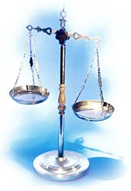
Measurements,
Calculations,
and
Conversions

Slide 11
Taking Measurements

Slide 12
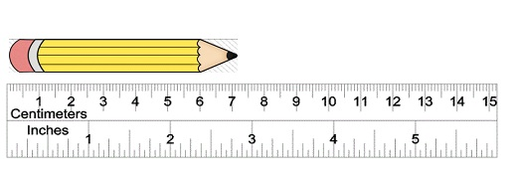

Slide 14
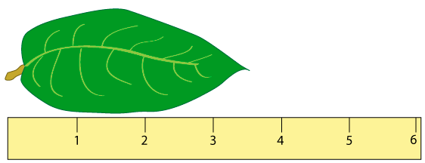

Slide 15
Take measurements of:
Water in a:
50 mL beaker
10 mL grad cylinder
50 mL grad cylinder
String with a :
Ruler

Slide 17
Metric System
Page 1 of blue unit book

Slide 18
The Fundamental SI Units (le Système International, SI)

Slide 19
Conversion in Metrics
King Henry Died By Drinking Chocolate Milk
Kilo | Hecto | Deka | Base | Deci | Centi | Milli
k | h | dk | g,L,m | d | c | m

Slide 20
You must SHOW YOUR WORK
Swinging the decimal will not work anymore

Slide 21
Find the number of m in 2.35 km.

Slide 22
Find the number of km in 756 cm

Slide 23
Find the number of dL in 52.4 hL.

Slide 24
Why I am being picky about the way you solve metric conversions
Given the following equation: 2 K + Cl₂ ---> 2 KCl
How many grams of KCl is produced from 2.50 mg of K and excess Cl₂.

Slide 25
Metrics Lab Instructions
Groups of 2
Measure two DIFFERENT objects per station
Each group member taking a turn measuring, not just one person
Take measurements at all stations FIRST, worry about converting AFTER you have measured at each station.
Station 7– can be set up on your own

Slide 26
What I’m looking for
Your measurements
CIRCLE the estimated digit
Include UNITS
Your calculations
Do calculations on separate sheet and SHOW ALL WORK if you want credit
Record answers back in your data table, WITH UNITS

Slide 27
Metrics Practice Problems

Slide 28
250 s = ? ms
8.53 g = ? dg
0.00475 kg = ? mg
1.47 mm = ? Km
0.85 cm = ? m

Slide 29
Scientific Notation

Slide 30
Scientific Notation
In science, we deal with some very LARGE numbers:
1 mole = 602000000000000000000000 molecules
In science, we deal with some very SMALL numbers:
Mass of an electron =
0.000000000000000000000000000000091 kg

Slide 31
Imagine the difficulty of calculating the mass of 1 mole of electrons!
0.000000000000000000000000000000091 kg
x 602000000000000000000000
???????????????????????????????????

Slide 32
Scientific Notation:
A method of representing very large or very small numbers in the form:
M x 10^{n}
M is a number between 1 and 10
n is an integer

Slide 33
.
2 500 000 000
9
8
7
6
5
4
3
2
1
Step #1: Insert an understood decimal point
Step #2: Decide where the decimal must end
up so that one number is to its left
Step #3: Count how many places you bounce
the decimal point
Step #4: Re-write in the form M x 10^{n}

Slide 34
2.5 x 10⁹
The exponent is the number of places we moved the decimal.

Slide 35
0.0000579
1
2
3
4
5
Step #2: Decide where the decimal must end
up so that one number is to its left
Step #3: Count how many places you bounce
the decimal point
Step #4: Re-write in the form M x 10^{n}

Slide 36
5.79 x 10⁻⁵
The exponent is negative because the number we started with was less than 1.

Slide 37
Review:
Scientific notation expresses a number in the form:
M x 10^{n}
n is an integer
1 ≤ M < 10

Slide 38
Scientific Notation Practice Problems

Slide 39
Express in correct scientific notation
61,500
0.0000568
321
64,960,000
0.07085

Slide 40
Significant Figures

Slide 41
Uncertainty in Measurement
A digit that must be estimated is called uncertain. A measurement always has some degree of uncertainty.

Slide 42
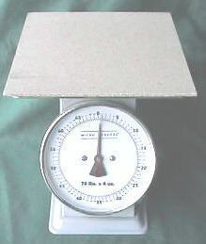
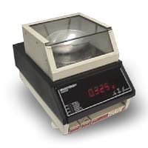
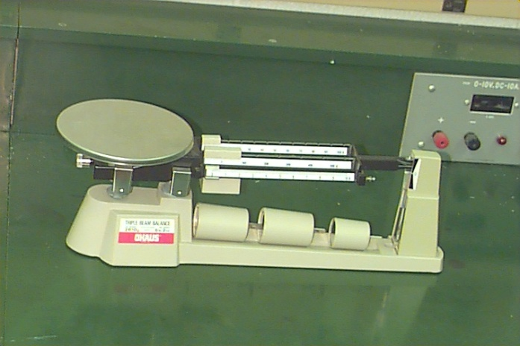
Why Is there Uncertainty?
Measurements are performed with instruments
No instrument can read to an infinite number of decimal places
Which of these balances has the greatest uncertainty in measurement?

Slide 43
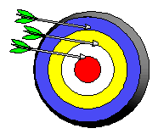
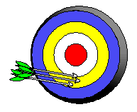
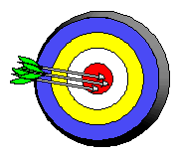
Precision and Accuracy
Accuracy refers to the agreement of a particular value with the true value.
Precision refers to the degree of agreement among several measurements made in the same manner.
Neither accurate nor precise
Precise but not accurate
Precise AND accurate

Slide 44
Rules for Counting Significant Figures - Details
Nonzero integers always count as significant figures.
3456 has
4 sig figs.

Slide 45
Rules for Counting Significant Figures - Details
Zeros
- Leading zeros do not count as
significant figures.
0.0486 has
3 sig figs.

Slide 46
Rules for Counting Significant Figures - Details
Zeros
- Sandwiched zeros always count as significant figures.
16.07 has
4 sig figs.

Slide 47
Rules for Counting Significant Figures - Details
Zeros
Trailing zeros are significant only if the number contains a decimal point.
9.300 has
4 sig figs.

Slide 48
Rules for Counting Significant Figures - Details
Exact numbers have an infinite number of significant figures.
1 inch = 2.54 cm, exactly

Slide 49
Sig Fig Practice #1
How many significant figures in each of the following?
1.0070 m →
5 sig figs
17.10 kg →
4 sig figs
100,890 L →
5 sig figs
3.29 x 10³ s →
3 sig figs
0.0054 cm →
2 sig figs
3,200,000 →
2 sig figs

Slide 50
Rules for Significant Figures in Mathematical Operations
Multiplication and Division: # sig figs in the result equals the number in the least precise measurement used in the calculation.
6.38 x 2.0 =
12.76 → 13 (2 sig figs)

Slide 51
Sig Fig Practice #2
Calculation
Calculator says:
Answer
3.24 m x 7.0 m
22.68 m²
23 m²
100.0 g ÷ 23.7 cm³
4.219409283 g/cm³
4.22 g/cm³
0.02 cm x 2.371 cm
0.04742 cm²
0.05 cm²
710 m ÷ 3.00 s
236.6666667 m/s
240 m/s
1818.2 lb x 3.23 ft
5872.786 lb·ft
5870 lb·ft
1.030 g ÷ 2.87 mL
.3588850174 g/mL
.359 g/mL

Slide 52
Rules for Significant Figures in Mathematical Operations
Addition and Subtraction: The number of decimal places in the result equals the number of decimal places in the least precise measurement.
6.8 + 11.934 =
18.734 → 18.7 (3 sig figs)

Slide 53
Sig Fig Practice #3
Calculation
Calculator says:
Answer
3.24 m + 7.0 m
10.24 m
10.2 m
100.0 g - 23.73 g
76.27 g
76.3 g
0.02 cm + 2.371 cm
2.391 cm
2.39 cm
713.1 L - 3.872 L
709.228 L
709.2 L
1818.2 lb + 3.37 lb
1821.57 lb
1821.6 lb
2.030 mL - 1.870 mL
0.16 mL
0.160 mL

Slide 54
Dimensional Analysis
Find where to start/end
Cancel units (make fractions)
Use conversion factor (metric system if necessary)
Multiply/Divide as needed

Slide 55
Conversion Factors
A ratio that is derived from the equality of two different units that can be used to convert from one unit to the other
5 dozen eggs = how many individual eggs?
CONVERSION FACTOR
1 dozen = 12 individual
5 dozen x 12 individual = 60 individual eggs
1 dozen

Slide 56
Practice Problem # 1
How many meters are in 2.19 yards?
Conversion Factors - 1 yard = 3 feet
1 inch = 2.54 cm

Slide 57
Practice Problem # 2
Convert 840,718 cm to miles
Conversion: 1 mile = 5280 feet

Slide 58
Practice Problem # 3
A car is traveling 35 mph. How many yards/second is the car traveling?

Slide 59
Practice Problem # 4
Convert 45.7 cm³ to hL.

Slide 60
Practice Problem # 5
How many millizags are in 2340 bozangles?
Conversion Factors – 1 gambly = .787 bozangles
1 zag = 2.85 gamblys

Slide 61
The density of helium gas is 0.178 g/L. What would the mass of 375.0 mL of this gas be?

Slide 62
Dimensional Analysis Practice Problems

Slide 63
54 gills is equal to how many gallons?

Slide 64
Convert a speed of 73.5 km/hr to its equivalent in m/s.

Slide 65
The density of iron is 7.86 g/mL. What volume of iron will have a mass of 50.00 g?

Slide 66
A sample of seawater contains 6.277 g of sodium chloride per liter of solution. How many mg of sodium chloride would be contained in 15.0 mL of this solution?

