Slide 1
Gases
Unit 11

Slide 2
Characteristics of Gases
Where are they found?
Everywhere!
Can we see them?
Most are invisible
What gases are in the atmosphere?
78% N₂
21% O₂
1% Ar
< 1%CO₂

Slide 3
Explanation of characteristics of gases

Slide 4
Characteristics of Gases
Have mass & occupy space.
Separated by relatively large distances.
Are in constant, rapid, random motion.
Exert pressure when collide with walls of container.
Easy to compress.
Gases with lightest mass travel fastest.

Slide 5
1) Have mass and occupy space
Matter: “anything that has mass and takes up space”
Gases do both of these!
Ex) molar masses of gases on the periodic table
Make a prediction:
The mass of a soccer ball deflated
The mass of a soccer ball inflated
The same, heavier, lighter??
Watch video:
http://www.youtube.com/watch?v=_p--sGYfGnU
Notes:
Image/explanation of each particle in balloon having mass: http://www.youtube.com/watch?v=BsnS2NHIkl4
http://www.youtube.com/watch?v=NhKtnJDUQt4

Slide 6
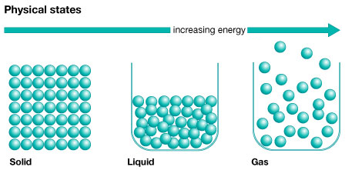
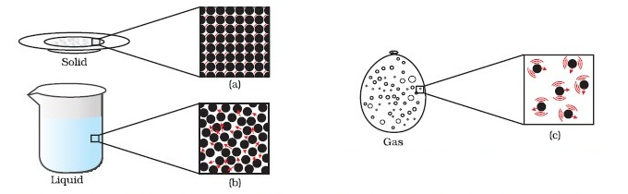
2) Separated by relatively large distances 3) Constant, rapid, random motion
Gases molecules are spread further apart and move much faster than solids and liquids
They never stop moving!
Notes:
http://mutuslab.cs.uwindsor.ca/schurko/animations/avogadro/avogadro.htm

Slide 7
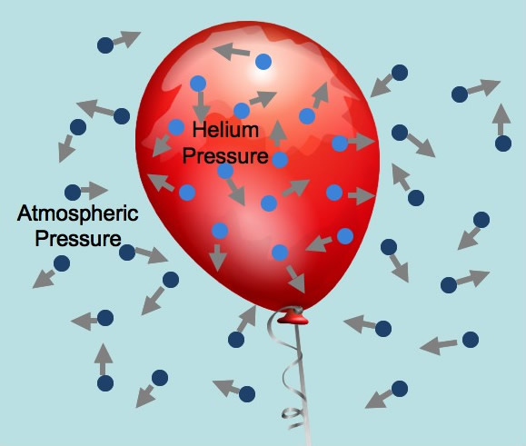
4) Exert pressure when collide with walls of container
Ex) a helium filled balloon
The helium on the inside of the balloon exerts pressure on the inside walls of the balloon
The gas molecules in the atmosphere collide with the outside walls of the balloon
Ex) more particles = more pressure = balloon inflated more
http://mutuslab.cs.uwindsor.ca/schurko/animations/avogadro/avogadro.htm
Notes:
Balloon Animation
http://mutuslab.cs.uwindsor.ca/schurko/animations/avogadro/avogadro.htm
1) What keeps the balloon inflated?
2) How does the speed of the particles relate to the number of collisions with the walls of the balloon?
3) The balloon at the left has hydrogen (H₂) and the balloon at the right has carbon dioxide (CO₂). Why are the H₂ molecules moving faster than the CO₂ molecules?
4) Change the number of CO₂ particles on the right balloon to 4. What happens to the size of the balloon?
5) What is the relationship between the number of gas particles and volume?

Slide 8
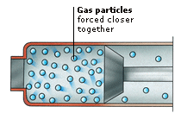
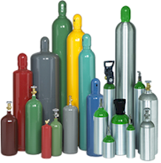
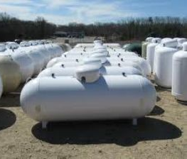
5) Easy to compress
Because there is so much space between gas molecules
Demo: textbooks on cylinder
Convenient for transporting commercial gases
Liquid propane, acetylene, oxygen
Can be hazardous
MythBusters:
http://www.youtube.com/watch?v=ejEJGNLTo84
Notes:
Myth busters: http://www.youtube.com/watch?v=ejEJGNLTo84
Behavior of gas particles when compressed (animation): http://www.youtube.com/watch?v=dQeCEqkE9eE
http://www.youtube.com/watch?v=WrM5SQrRTMM

Slide 9
6) Gases with the lightest mass travel fastest
Animation: http://mutuslab.cs.uwindsor.ca/schurko/animations/avogadro/avogadro.htm
The balloon at the left has hydrogen (H₂) and the balloon at the right has carbon dioxide (CO₂). Why are the H₂ molecules moving faster than the CO₂ molecules?

