Slide 1
Bell work
Page 3
8-12 MINUTES
Please have out homework so that I can come around to check it.

Slide 2
Atomic Theory and Atomic Structure

Slide 3
Atomic Theory
Atoms are building blocks of all matter

Slide 4
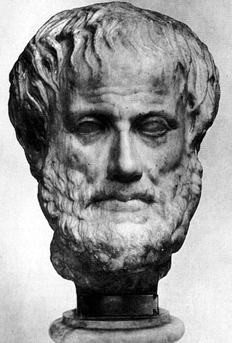
Aristotle
Matter was continuous and could be divided indefinitely without changing its intrinsic properties

Slide 5
Democritus
Thought all matter was made of small, indivisible particles called ATOMS (coming from the Greek word meaning indivisible).
The difference was in the arrangement of atoms

Slide 6
2000 yrs later…. John Dalton
English school teacher
Developed model of nature of matter that explain a lot of experimental findings like laws of mass conservation and definite proportions
His theory was based on Democritus but went much further

Slide 7
Dalton’s Atomic Theory
Atoms cannot be divided, created or destroyed
Atoms made of only one kind of element have identical physical and chemical properties
Compounds are made of two or more kinds of atoms
Only whole numbers of atoms can combine to form compounds
In chemical reactions, atoms are combined, separated or rearranged to form new products.

Slide 8
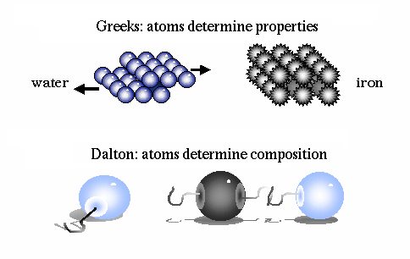

Slide 9
1897 – Joseph John Thomson
English physicist
Confirmed the existence of the electron
Thought atoms were a positive matrix with electrons embedded
Like “plum pudding” with raisins
Nestlé Toll House

Slide 10
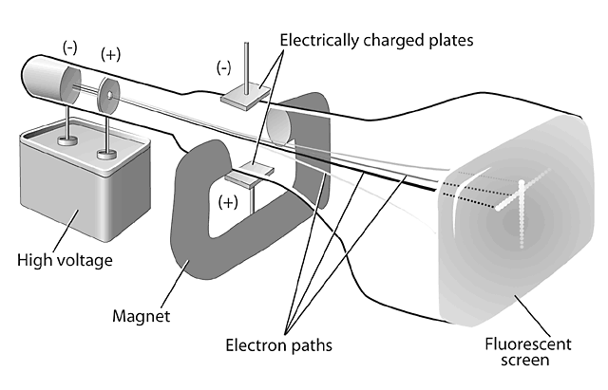
Thomson Experiment

Slide 11
Millikan Oil Drop Experiment -1909
Measured the charge of the particle discovered by Thomson – the electron
Was able to suspend tiny oil drops in an electrical field and accurately measure their charge

Slide 12
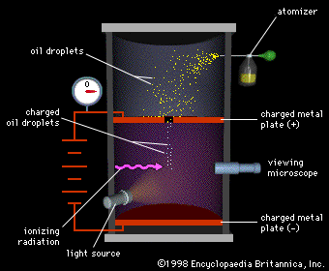

Slide 13
1909 – Ernest Rutherford
Discovery of Nucleus
Beam of alpha particles (small, positive charge)
Thin gold foil
A few alpha particles were deflected
Hypothesized there is a positively charged nucleus with a mass – not the plum pudding model!

Slide 14
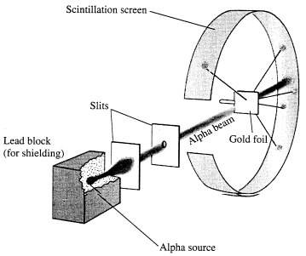

Slide 15
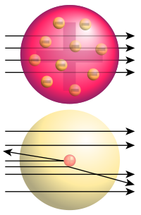
Top: Expected results: alpha particles passing
through the plum pudding model of the atom
undisturbed.
Bottom: Observed results: a small portion of
the particles were deflected, indicating a small,
concentrated positive charge. Note that the image
is not to scale, in reality the nucleus is
vastly smaller than the electron shell

Slide 16
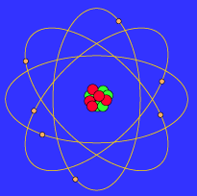
Rutherford Planetary Model
Bohr elaborated on the planetary model….

Slide 17
J. Chadwick
Bombarded Beryllium with α particles
Found that highly energetic, uncharged particles were emitted (called neutrons)

Slide 18
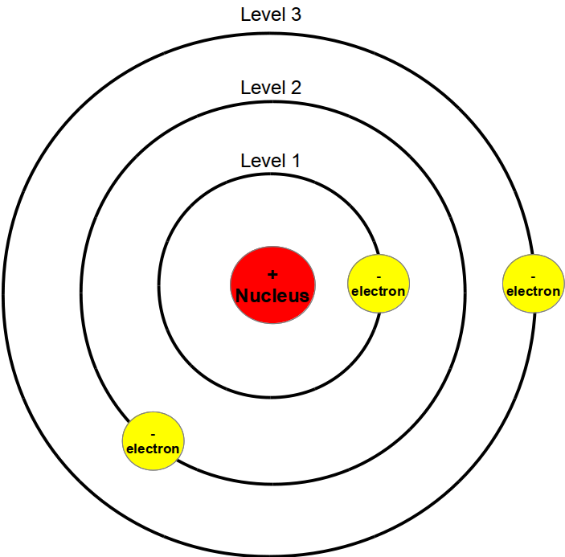
The Bohr Model of the Atom What did Bohr learn about electron movement?
Bohr proposed that electrons move in paths (orbit) at certain distances around the nucleus.
Electrons can jump from a path on one level to a path on another level.

Slide 19
Erwin Schrodinger- Quantum Mechanical Mode;1926
Used mathematical equations to describe the likelihood of finding an electron in a certain position.
Does not describe exact path, but predicts odds of location of electron.
Shown by nucleus surrounded by electron cloud.

Slide 20
Law of Definite Proportions
every pure substance always contains the same elements combined in the same proportions by weight
Every sample of water contains of oxygen 89% and 11% Hydrogen by weight

Slide 21
Law of Conservation of Mass
The mass of the reactants in a reaction equals the mass of the products.
Mass cannot be created or destroyed in chemical and physical changes

Slide 22
Law of Multiple Proportions
You can’t have half an atom
The mass of each element must be in ratio of whole numbers

Slide 23
Scientists
Atom- Democritus
Electron- Thomson (cathode ray)
Neutron- Chadwick (Beryllium with α)
Nucleus- Rutherford (planetary model)
Proton- Rutherford (gold foil)
Charge of e- Millikan (oil drop)
Atomic Theory- John Dalton
Orbits- Bohr
Quantum mechanical model-Schrodinger

