Slide 1
UNIT 2 Protons, Neutrons, Electrons

Slide 2
Element: Most fundamental unit of matter. They cannot be broken down without losing their identity.
Atom: the tiniest bits of an element. They consist of protons, neutrons, and electrons.
Proton: found in the nucleus. Have a +1 charge and a mass of about 1 atomic mass unit (amu)
Neutron: found in nucleus. They are neutral, and have a mass of about 1 amu.
Electrons: surround the nucleus. Have a charge of -1, and a mass of 0 amu.

Slide 3
Calculating protons, neutrons electrons
Periodic table- intro
Periodic table = tool to make life easier

Slide 4
Periodic Table
Atomic Number = Protons
30
Zn
Zinc
65.39
[Ar]3d¹⁰4s²
Mass Number=
Protons + neutrons

Slide 5
Atomic & Mass Numbers
Atomic Number- never changes
Atomic # = number of protons
Each element has a unique atomic number
Mass Number (atomic mass)
Total number of particles in the nucleus
Protons + Neutrons
APE MAN no longer works (learn why things happen)

Slide 6
Protons= electrons (sometimes)
Finding electrons
Deals with + and –
In order for neutrality to happen
+ must equal –

Slide 7
Shorthand
¹H ⁴He ⁹Be
Atomic mass ---------→
₂
₄
₁
Atomic # -------→
C-12 Ca-40 La- 139
Atomic symbol – atomic weight

Slide 8
Where did that 0.39 come from?
Isotope- an atom that has the same number of protons, but has a DIFFERENT NUMBER OF NEUTRONS
The weight may be different than the Periodic table
The atomic weight of an element is an average of all of the atoms of that element on earth

Slide 9
30
Zn
Zinc
65.39
[Ar]3d104s2
Atomic number =
30 protons
Mass # = P⁺ + n⁰
65.39 = 30 + n⁰
n⁰ = 35.39?????
How can you have 0.39 of a neutron in the nucleus???
You can’t = the answer is 35….usually

Slide 10
Ions
Atoms with a charge because number of electrons change. (+ nucleus does not match – outside)
Cation—positive charge atom
Anion—negative charge atom

Slide 11
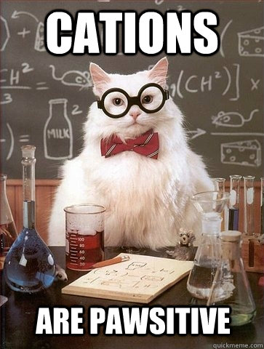

Slide 12
Electrons
Elements in their natural state have a neutral charge
# p⁺ = # e⁻
ION – an atom that has uneven # of protons and electrons – has a total charge
Na⁺ Ca⁺² Cl⁻

Slide 13
What happens when we change a piece of the atom?
Proton | Changes Atom completely | Li → Be Cs → Ba
Electron | Changes charge of the atom | Becomes an ION Ex. Cation/ Anion
Neutron | Changes the weight of the atom | Becomes an ISOTOPE C-12 → C-14

